Slide 1
Best Practices in Utility Billing and Payments

Slide 2
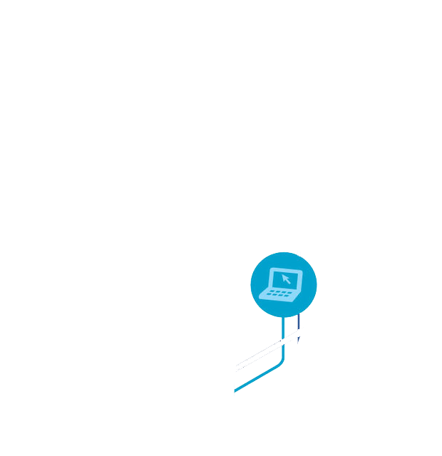
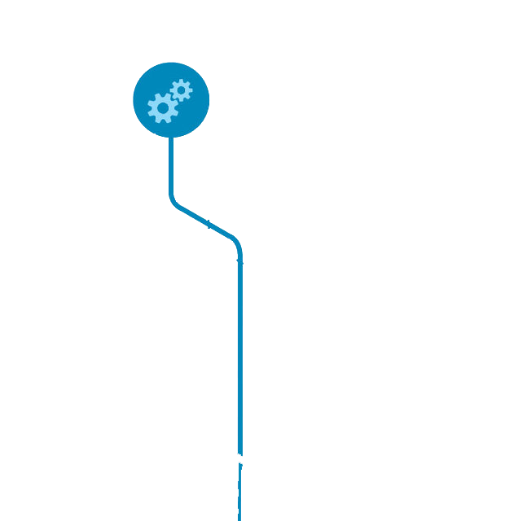
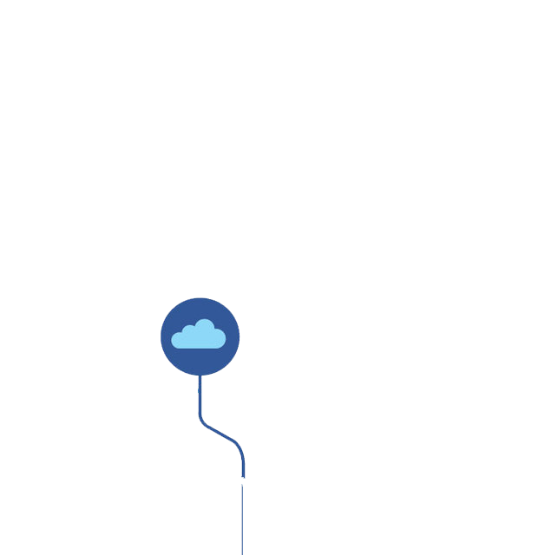
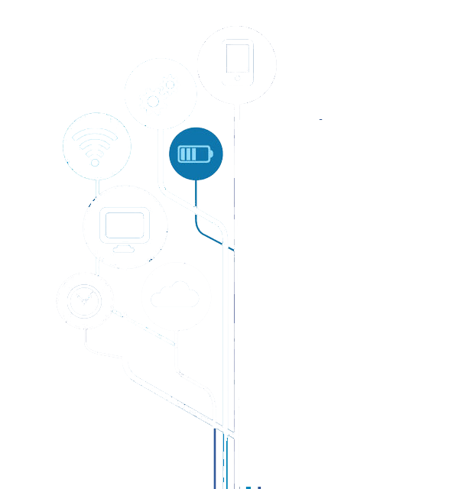
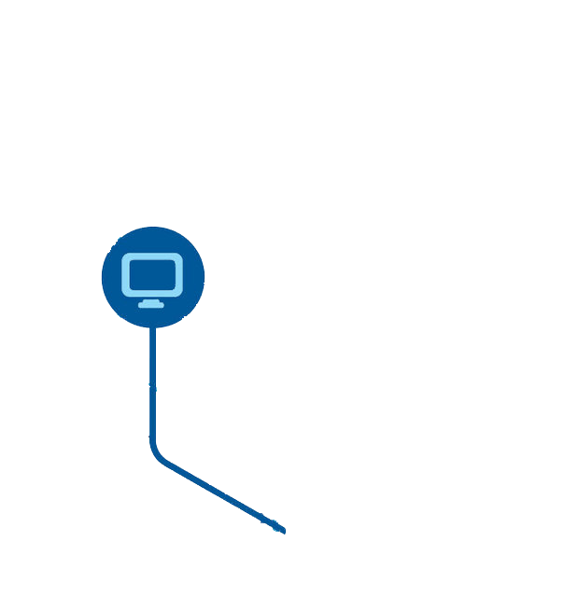
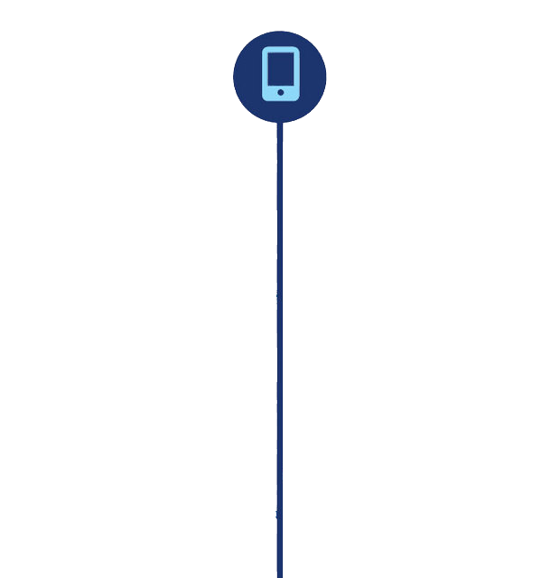
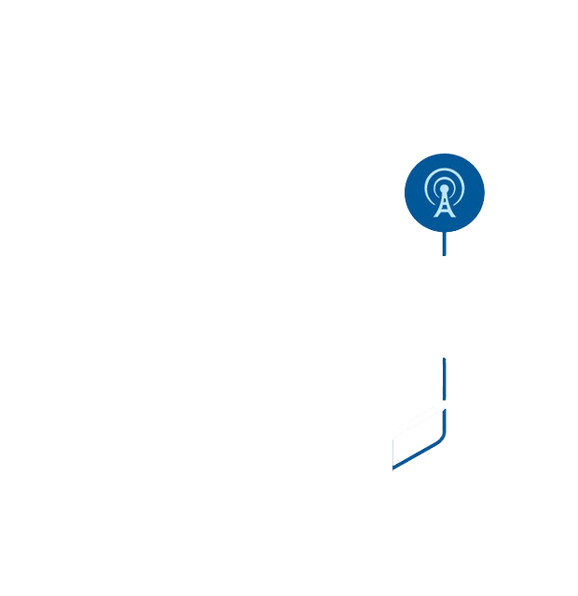
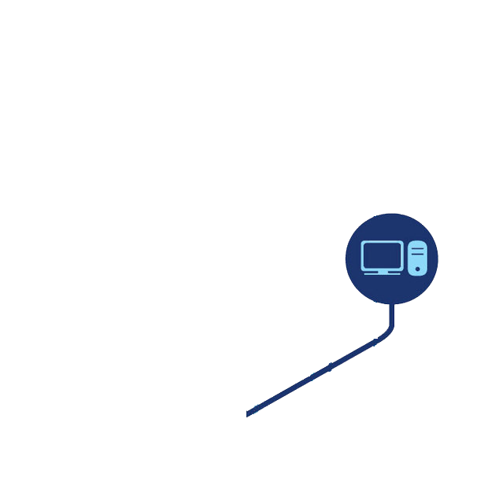
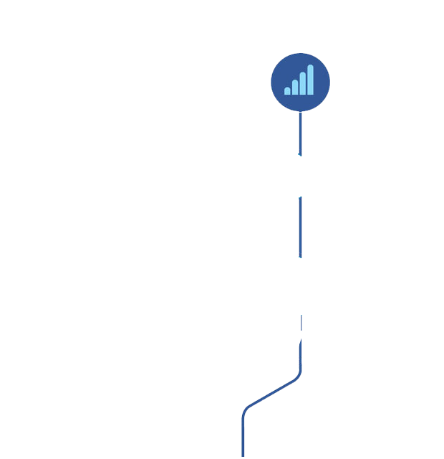
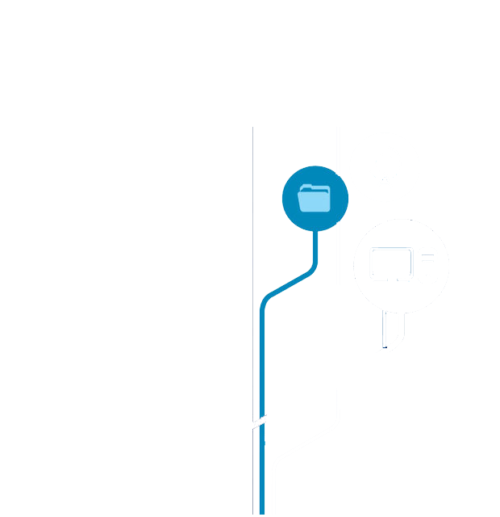
digital technologies
Notes:
Effective billing and collection systems form the core of successful utility businesses. The rapidly changing industrial environment, convergence of digital devices and technologies with traditional business processes, and the presence of digitally advanced consumers are collectively making these two processes increasingly complex for the utilities industry.

Slide 3
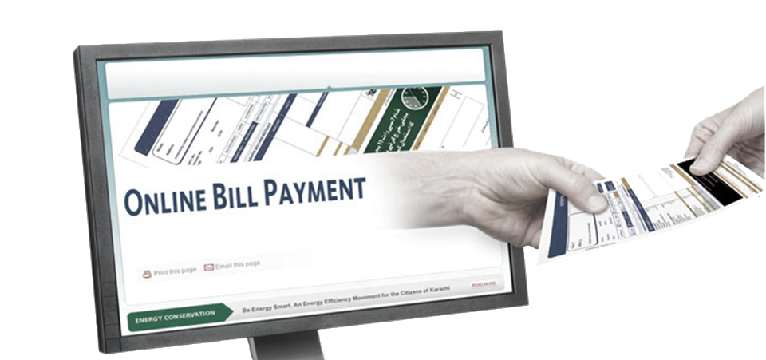
real time
4 out of 5
bank online
Notes:
Four out of five U.S. households with Internet access now bank online, according to the results of a recent Fiserv Inc. survey. Consumers have the entire world at their fingertips. Options abound to connect, communicate, shop and pay – all it takes is a few taps on a mobile device. Such real-time experiences have not only become commonplace, but they’ve become essential to everyday life. And when it comes to paying bills, consumers expect the same – the ability to make payments wherever, whenever, however.

Slide 4
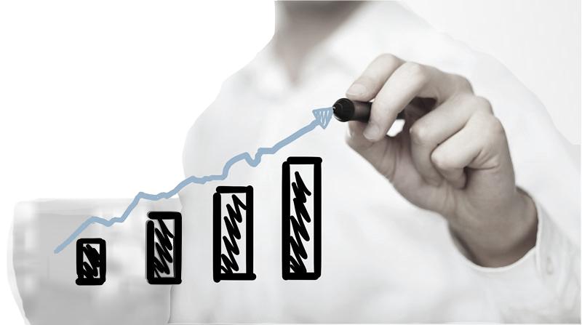
scalable
smart billing software products
Notes:
Utilities have begun to understand that to deliver services in line with the rising expectations of convenience options with the ability to make payments wherever, whenever, however. Current legacy billing and customer information systems may not be suitable for the long term. As such, utilities are switching to smart billing software products that are more capable of handling the expectations of not only today, but tomorrow. Highly scalable utility billing software will help allow utilities to more effectively serve the consumers and improve overall positive perception of the utility.

Slide 5
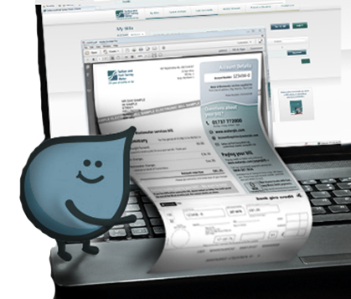
General Consumer Billing and Payment Trends
Billing (Fiserv)
Majority receive mix of paper and paperless
2. ½ say interested in going paperless
Notes:
Billing (Fiserv)
Majority receive mix of paper and paperless
½ say interested in going paperless

Slide 6
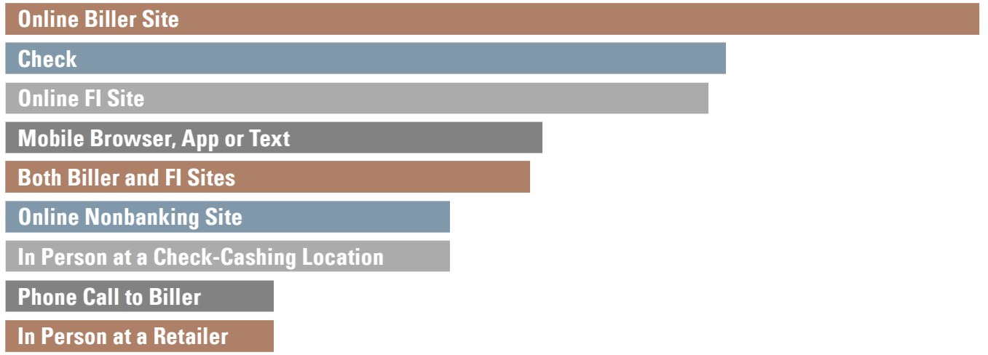
General Consumer Billing and Payment Trends
Current Top Payment Methods
Fiserv
Notes:
As the number of bill pay channels increases, more traditional payment methods, such as checks,
still remain. This makes it even more complicated to support and manage the growing bill pay
ecosystem. The challenge for billers is to create the intuitive, seamless options consumers have
come to expect.

Slide 7
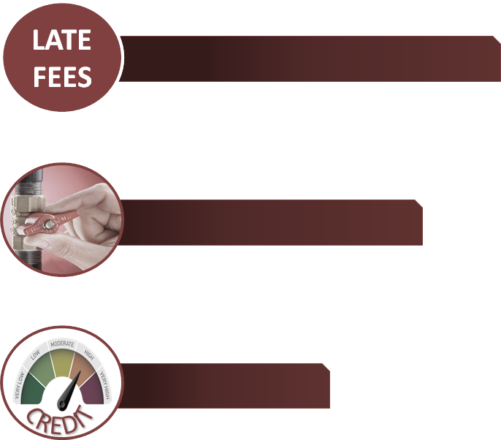
84%
Influences
60%
48%
First Data
Notes:
A. Key influences: (First Data)
1. Late fees 84%
2. Service shutoff 60%
3. Credit score 48%

Slide 8
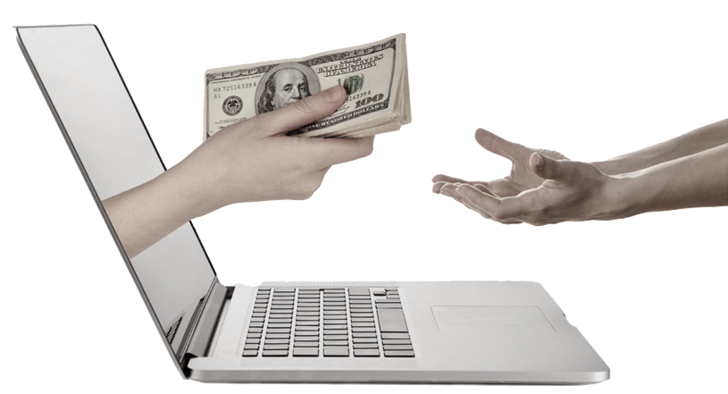
REAL TIME
70% same day credit
90% no later than next day
Influences
Fiserv

Slide 9
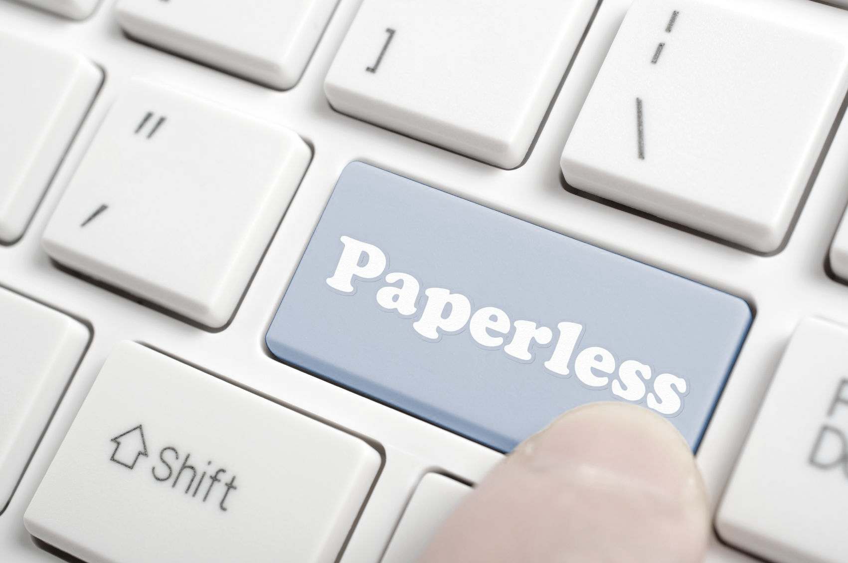
Other Key drivers:
1. Variety of options in billing and payment
2. E-billing/reduction of paper
Influences
Notes:
What influences people to pay online or use electronic billing?
They like to have a variety of options. For utilities with larger customer bases, the more options you have the better, because there will always be a group of customers that prefer one method over another.
Reducing the impact of paper and ink on the environment is still a deciding factor for a lot of Americans

Slide 10
S
Current Trends & Projections
Speed
Security
Satisfaction
Fiserv
Notes:
What are your customers looking for in electronic billing and payment offerings?
Speed - Payment options need to synch with consumers’ busy lives. Real-time options, including emergency payment options, are a must.
Security - It’s all about trust. Consumers need to know they can trust their payments are secure, regardless of how they make them.
Satisfaction - Consumers want things on their terms. Affording a variety of ways to receive and pay bills leads to greater satisfaction

Slide 11
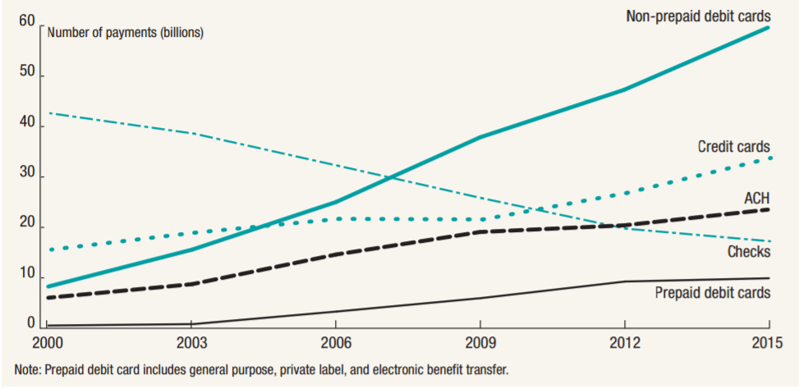
Current Trends & Projections
decline in paper checks
Notes:
Mail in payments declining
Check use in the United States has been on the decline for years, as other more modern forms of payment – credit cards, debit cards, prepaid, and ACH – have taken o­ff in popularity.

Slide 12
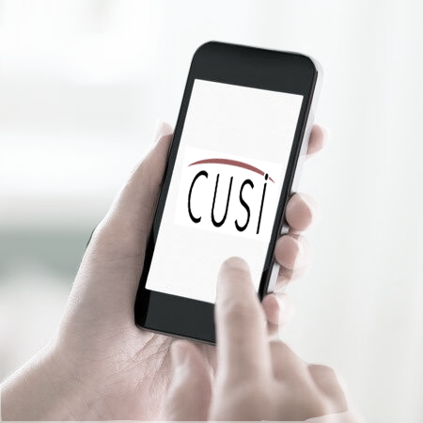
Current Trends & Projections
Mobile payment options
Higher customer satisfaction
Mobile self-service engagement
E-bill activations
Crunch Network
Notes:
Mobile increasing
The market for mobile bill pay is growing and is not near saturation. Mobile bill payment options can result in higher customer satisfaction, mobile self-service engagement and e-bill activations. Responsive design websites not necessarily apps.

Slide 13
Current Trends & Projections
2016: 4.8 billion
Mobile payments
2014: 25%
2015: 39%
2017: 70%
2020: 90%
Crunch Network
Notes:
More than 4.8 billion individuals used a mobile phone in 2016. A recent report noted that 39 percent of all mobile users in the U.S. had made a mobile payment in 2015. This is up from 14 percent in 2014 and by estimations will be in the 70 percent range by the end of this year.
2020: 90 percent of smartphone users will have made a mobile payment. It’s estimated that this year, there will be $60 billion in mobile payment sales. (Crunch Network)
.

Slide 14
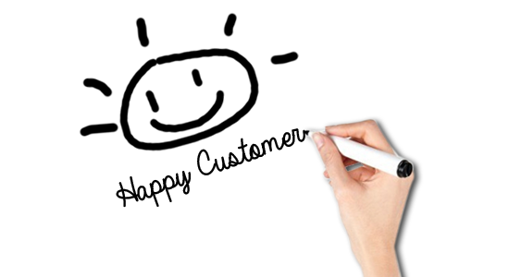
Why should Utilities offer these solutions
Save money
Convenience – improve cash flow
Self Serve – free up staff for other duties
Customer satisfaction – customers expect diverse options
Notes:
IV. Why should Utilities offer these solutions
Money saving
Convenience - Improve cash flow
Self Serve - Free up staff for other duties
Customer satisfaction – customers expect diverse options.

Slide 15
educate board and staff
Implementation
Notes:
Start internal education process immediately
Board
Staff
Don’t be afraid of change

Slide 16
Evaluate costs
payment processing
salary/benefits
posting payments
bank deposit prep
Implementation
Notes:
Evaluate costs of current billing and payment efforts
1. Payment processing
a. Salary/benefits
b. Posting payments
c. bank deposit prep

Slide 17
Evaluate costs
printing/mailing costs
salary/benefits
card/paper stock
postage
equipment & supplies, overhead
Implementation
Notes:
Evaluate costs of current billing and payment efforts
2. Printing/mailing costs
a. Salary/benefits printing and mailing
b. Card stock
c. Postage
d. Equipment and supplies, overhead
3. Still paying if you use a 3rd party bill print

Slide 18
Evaluate benefits
improved cash flow
free staff
customer satisfaction
Implementation
Notes:
Evaluate Benefits
Improved cash flow
Free staff for other duties/best use of time
Customer Satisfaction

Slide 19
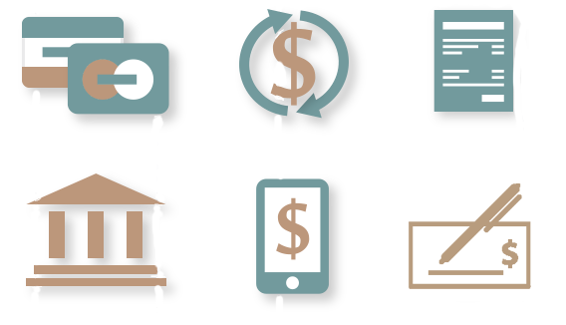
Options
Implementation
Notes:
Offer variety of payment options and paperless billing

Slide 20
Promotional campaign
bill messages/inserts
website notices
news
education
enrollment incentives
brochures and posters
Implementation
Notes:
E. Schedule a Promotional Campaign
1. Bill messages/inserts
2. Website notices
3. News releases for local media, utility newsletter
4. Intra utility staff education, proactively pursue customer participation
5. Incentives for enrollment
6. Brochures and posters in office

Slide 21
Questions?
www.cusi.com/bestpractices
Charli Jo Ledgerwood
Director of Midwest Sales
cjledgerwood@cusi.com
www.cusi.com
870.336.2200

